Slide 1
Project Based Seminar Indoor Navigation System Guide :- Prof. Rachna Chhajed
Group members :-
1.Neha Jaju (33224)
2.Komal Parmar (33144)
3.Manvi Pandya (33235)

Slide 2
Abstract :
Indoor navigation system is mobile based application focusing on providing easy navigation facilities to the users for locating a specific location in any building considering all aspects including different floors of the building.
The platform is modularized and provided access according to the primary users and their responsibilities:
Users (online/offline)
Owner of the building/campus (Admin)
Mediator(may exists or not)
Features :
3D map visualization (using Augmented Reality)
Custom Design
Emergency Buttons (call nearby police, ambulance, fire brigade).
Find a friend (help the user trace other user within the map boundaries with their consent).
Voice Navigation.

Slide 3
Domain :
Machine Learning (algorithms to find shortest path if optimisation doesn’t work).
IOT (for beacons)/ Augmented Reality / Other (depending on the technology used to find position).
GIS and Geofencing
Data analysis

Slide 4
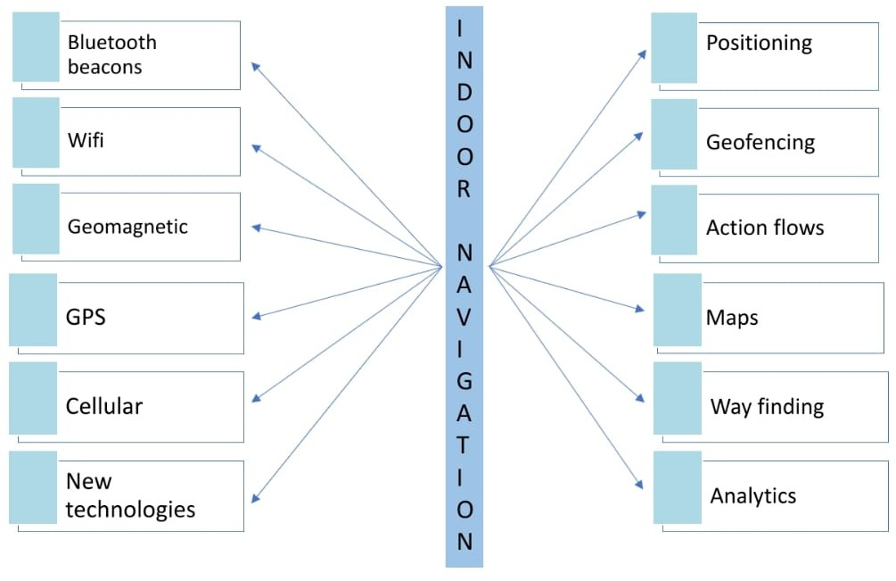

Slide 5
Time-Efﬁcient Indoor Navigation and Evacuation With Fastest Path Planning Based on Internet of Things Technologies
INTRODUCTION :
This section tells us about time-efﬁcient indoor navigation and evacuation (TINE) framework with moving time minimization through IoT localization technologies. TINE can provide a navigation path with the shortest moving time to a target place in normal time without emergency. TINE can help all mobile users to provide the shortest total escaping time when an emergency event happens (e.g., ﬁre or earthquake) by handling the congestion. TINE provides distance awareness, capacity awareness, density awareness, mobility modeling, dedicated group route, dynamic evacuation order.
The framework of TINE is fourfold as follows :
The moving time to pass through each passageway/area is estimated by mapping the densities of mobile users to their walking speeds in all passageways/areas.
The fastest path to an arbitrary target place for indoor navigation in normal time is planned without requiring the highly accurate location of each mobile user.
The up-to-date distribution of mobile users, the capacities and lengths of passageways/doors/exits, and the possible intergroup congestion are jointly considered to dynamically determine the evacuation orders of groups.
The total escaping time for emergency evacuation is minimized by providing the shortest time path to an exit to each group.

Slide 6
SYSTEM MODEL :
IoT localization (i.e. iBeacon nodes with Bluetooth low energy broadcasting) and wireless Internet access (i.e., Wi-Fi access points). The smartphones with Bluetooth low energy scanning are used by mobile users.
When a mobile user sends a navigation request (with a target place) to the guiding server in normal time, a dedicated navigation path (to the target place) is planned and then replied based on the mobile user’s present position and the density of indoor people for providing the shortest moving time
The basic goals of TINE are accomplished by addressing following issues:
Navigation of Fastest Route
Determination of Group Evacuation Order
Detection of Congested Passageway/Exit
Evacuation of Shortest Time Path
TIME-EFFICIENT INDOOR NAVIGATION AND EVACUATION :
A graph is constructed for a given place in which the vertices include door, exit an crossing vertices and edges between these vertices. The additional edges are included in graph is for stairs between different ﬂoors in a multiﬂoor building.
The design is based on fastest speed and adaptive ordering schemes to minimize the total moving and escaping times for indoor navigation and evacuation, respectively.
Fastest Speed Navigation : In our fastest speed navigation, all passageways between vertices in edge are weighted by the average moving time of passageways in which the density of passageways can be transformed through the formula.
Adaptive Ordering Evacuation : In the adaptive ordering evacuation, the evacuation path is planned taking the spatial and temporal mobilities of mobile users into account based on their nearest iBeacon positions, which can provide the shortest escaping time for each mobile user nearby the same iBeacon.

Slide 7
CONCLUSION :
The app guides the user to a target place in normal time and to an exit in emergency
time as quick as possible. This app considers distribution of people, the densities,
speeds, capacities, and lengths of passageways/exits, the possible congestion
caused by other people and the dynamic guiding orders of groups for fastest path
planning. It is implemented with Android-based indoor navigation and evacuation
prototype based on iBeacon IoT localization and smart handheld devices.

Slide 8
Indoor Navigation System using BLE Beacons
Introduction :
This section emphasis on need of Indoor Navigation and how Beacons can be used (GPS can’t be used).Beacon Placement is another important aspect. It will be implemented using computer vision and artificial intelligence techniques rather than Manual beacon placement as locations and path computations is time-consuming and labour-expensive, especially for large indoor spaces . And unlike traditional Apps the plan is to use web-app that is as soon as phone enters in beacon area user gets a URL as notification and using it one can access web-app.
Overview :
In this section 11 different IEEE papers were referred .
Beacon implemented system for mobile content management
Manual determination of all beacon placement.
Beacon Placement for Indoor Localization using Bluetooth
Bluetooth devices have former shorter range. cell based method is found to be more accurate and advantageous over the others for localization.
Survey of Wireless Based Indoor Localisation Technologies
The three main methods for indoor localisation are:
Vision Based Indoor Localisation(using Camera)
Wireless Based Indoor localisation(using chips)
Smartphone Sensors(accelerometer, the compass, and the gyroscope)

Slide 9
An Analysis of the Accuracy of Bluetooth Low Energy for Indoor Positioning Applications
Comparison between Wi-Fi System and Beacons. Experiments were conducted and on the basis of position Accuracy it is analysed that
active Wi-Fi scanning and Wi-Fi network access can lead to faulty signal strength measurement
BLE Deployment Density
Various observations are as follows:
Smartphone sensors merely detect BLE signal measurements with RSS readings ranging near -100 dBm.
Attenuation of 1 dB can be considered per meter of interior space
Each wall leads to signal loss ranging in 2 - 3 db.
(Equation was given but not clear .Format issues)
*Nearby Messages and Nearby Notifications
Installation of app is not required and most importantly used to understand what is around the user.
Can be used both with Eddystone and iBeacon.
The Eddystone Format
This paper contains information about Eddystone and how similar and different it is from iBeacon
Automatic Floor Plan Analysis for Adaptive Indoor Wi-Fi Positioning System
Fetching the geographical areas(corridors, doors etc) from the floor plan and thus generating weighted graph. All information are stored in DSs which is further used create Euclidean graph.
Mapbox GL JS
It is a tool used to build custom map. Mapbox(WebGL platform) is a library for creating customized maps. The map can store additional data other than what we want to display which is useful in providing features like navigation, route finding etc.
User Positioning on map using Indoor Atlas Tool
For accurate Positioning combine different technologies ( Wi-Fi, BLE signals and geomagnetic data ).
Kontakt SDK for Android

Slide 10
EXISTING SYSTEMS :
Guide Map:
The main problem with the guide map is that one cannot carry it all the time.
MumbaiT2App
It is an app used by Mumbai airport for indoor navigation
Disadvantages:
App should be Installed.
User should be aware of the app.
App is Infrastructure specific.
PROPOSED SYSTEM :
There are 2 main components:
Mobile Application
As user enters in Beacon’s area URL is send which directs to App on which user gets the route which leads to destination.
Admin Panel:
User uploads the map, Beacon placement and detail of the place.
DESIGN :
Central Server : Platform where the website/app will be hosted.
Admin Panel (Same as above)
Smartphone : (sensors like Bluetooth, GPS, Accelerometer, Gyro meter, Magnetometer.) The Bluetooth and mobile data should be enabled.
Beacon Network
CONCLUSION :
The app gets the user location from the beacon nearby, Wi-Fi and geomagnetic field and navigates the user to the destination. It is based on dynamic interaction and adaptability to changes .

Slide 11
A Smart Indoor Navigation System over BLE
INTRODUCTION :
This section states that it is preferable to use simple and common technology with indoor navigation systems like Radio Frequency (RF) signals such as those emitted by Wi-Fi Access Points and Bluetooth devices. Nowadays, nearly all mobile phones are equipped with both Wi-Fi and Bluetooth adapters so it is easy to use these methods. It uses BLE based indoor navigation system to locate users position accurately in an inexpensive manner.
BACKGROUND :
In this section, several indoor positioning systems are discussed. One of the earliest location systems is Active Badge. In this system, a badge is pinned to the user.
Each badge emits infrared signals every ten seconds. Certain receivers receive these signals then send them to a central server. But, there are several shortcomings of this system, the accuracy of the location depends on the number of the receivers. Also, the range of the infrared signals is short. There are other location systems like mTag that is based on RFID (Radio Frequency Identifier), and other famous systems such as RADAR, PlaceLab, and Herecast that use Wi-Fi.

Slide 12
PROPOSED INDOOR NAVIGATION SYSTEM :
Here, the scanner (smartphone) reads the packets from iBeacons where the minimum number is three iBeacons. If the scanner received less than three points, Trilateration willignore these readings and take the previous three readings of packets, then sends it to the server to pass through the same.
Trilateration : Trilateration is used to find an unknown location fromat least three known locations. It uses the distancesfrom each of the known locations to determine the coordinateof the unknown location.
Particle Filter : A Bayesian filter is used to determine the state of anysystem that changes with time using a sequence of noisy measurements made on the system.
A* Algorithm : A* algorithm is an extension of the Dijkstra’s algorithm. Dijkstra’s algorithm is slower compared to A* because Dijkstra’s improves an initial approximation (cost) of each node repeatedly. Due to this, it takes more time to reach the target node.
PROPOSED SYSTEM HARDWARE IMPLEMENTATION :
Bluetooth Low Energy (BLE) : Bluetooth is a good alternative to GPS. The BLE can detect the user’s position accurately up to 1m. And it is compatible with both iOS and Android. In addition, the power consumption is low.
Estimate iBeacons : They are tiny, low-power computers that can be attached to walls or objects. Using proximity technologies, they detect human presence through their mobile phones and trigger preprogrammed actions delivering contextual and personalized experiences. Beacons are small, often inexpensive devices that provide a more accurate location within a narrow range than GPS or Wi-Fi proximity. Beacons transmit small amounts of data through Bluetooth up to 50 meters, so they are often used for indoor localization technology phone can determine which beacon it hears and how far it is. The size of iBeacons ID is 20 bytes and is divided into three sections:
UUID (16 bytes).
Major number (2 bytes).
Minor number (2 bytes).
Raspberry Pi : Raspberry Pi is a low-cost, basic computer that was originally intended to help spur interest in computing among school-aged children. There are several versions of the Raspberry Pi, but the version that is used in this project is Raspberry Pi 3. The Raspberry Pi acts as a scanner. The scanner code is written with Python.

Slide 13
PROPOSED SYSTEM SOFTWARE IMPLEMENTATION :
Backend :
LAMP : The LAMP platform consists of four components that are structured in a layered way Linux is the lowest-level layer in the LAMP platform. It provides the operating system and runs each of the other components.
• Apache is the web server. Apache provides the mechanics for getting a web page to a user. It is used together with PHP to create dynamic pages.
• MySQL provides the data-storage side of the LAMP system.
• PHP is a simple and efficient programming language that provides the glue for all the other parts of the LAMP system.
Front End :
The web page is designed with PHP and JavaScript. It is created on a local host. Here the web page will communicate with the database to find the user’s location and his destination, then through the A* algorithm code, which is written with Python, it detects the shortest path then displays it to the user.
EXPERIMENTAL RESULTS :
This indoor navigation system is launched as a pilot trial on the third floor, building 8, Faculty of Engineering Cairo University.

Slide 14
An Indoor Positioning and Navigation Application for Visually Impaired People using Public Transport
INTRODUCTION AND STATE OF THE ART :
This section states the importance of Indoor Navigation in Public Transportation and specially its importance for visually Impaired people. . Pedestrian Dead Reckoning (PDR) algorithms (based on inertial measurements) is used for visually impaired people rather than additional infrastructure.
CONCEPT OF THE DEVELOPED APPLICATION :
This project is basically a smartphone application for visually impaired to navigate within public transport systems
Application allows the person to request a navigation route and a timetable for Transportation.
e.g. Graz main railway station in Austria had implemented this project. With Destination different modes of transportation that can be used are shown (With respect to trams and buses, boarding and deboarding requests may be activated). Visual impaired usually use tactile paths for navigation.

Slide 15
INDOOR POSITIONING :
Positioning accuracy combined with high integrity is required . To achieve this graph-based PDR approach that uses the tactile paths, Bluetooth Low Energy (BLE) beacons, default location(Google Play Services) is used.
To construct the PDR algorithm following are required:
Altitude Estimation:
It is based on a quaternion estimation using inertial and magnetic observations.
This process is divided into 2 parts qacc and qmag
qb ll = qacc ⊗qmag
The quaternion estimation is performed via a ﬁltering process that involves a prediction step and a measurement update is done if new acceleration is available.
In the prediction step, the following equation is applied:
qb ll = qb ll +1/2 ([ 0 −ωb]⊗qb ll)dt
(ωb is the actual three-dimensional angular rate vector)
2. Graph-based PDR and Bluetooth Combination:
This method requires the use of a step detection Although this is not as accurate it works well in smartphone applications. The current step direction α can be estimated by using the data from the gyroscope, accelerometer and magnetometer. PDR algorithm is strongly generalized and is not accurate. Visually impaired people mainly use tactile paths thus the graph created consists of edges and nodes, represented by tactile paths. PDR algorithm only yields meaningful results if the blind or visually impaired user moves on top of these tactile paths.
Heading Estimation is also essential . the resulting heading information represents the difference between the current edge direction and the accumulated heading rate. If the position is matched to a new edge, the heading difference is reset to 0.
4 Cases to match a position are:
Straight ahead 2)Turn 3)180°-Turn 4)Global search
PDR algorithm needs starting position identiﬁed by BLE beacon(By applying cell-of-origin positioning technique)

Slide 16
C. Positioning service :
It is based on Threshold(T = 3σGPSLk(σPDR))
T < d(XGPSL,XPDR) ⇒GPSL
T ≥ d(XGPSL,XPDR) ⇒PDR+BLE .
Concluding, graph-based PDR is more suitable to routing and guidance applications
INDOOR NAVIGATION :
The shortest path is computed using Dijkstra’s algorithm, whereas the lengths of the edges are used as weighting criteria. With the graph-based PDR solution, routing is performed based on the tactile paths
To remove accuracy constraint
ANGLE REPRESENTATION FOR GUIDANCE INSTRUCTIONS are given
Angle Denomination
20° ≤ ∆α < 60° turn slight left/right
60° ≤ ∆α ≤ 145° turn left/right
∆α > 145° turn left/right sharply
CONCLUSIONS :
The system was designed to use Beacons, and the existing tactile paths for indoor navigation system in public transport systems, and especially for visually impaired people. It is used both Indoor and Outdoor because the application combines route planning processes and communication with the public transport vehicles. Tests and demonstrations conducted at the Graz main railway station can be used by visually impaired people to navigate within public transport systems.

Slide 17
Mobile Indoor Navigation System in iOS Platform Using Augmented Reality
INTRODUCTION :
Augmented reality is the perception of virtual and real objects at the same time by user. With augmented reality, the following features are included in the scene :
Virtuality and reality are combined.
It interacts in real time.
It has 3D utilization.
The application of indoor navigation system only utilizes smart phones’ accelerometer, compass and camera features and augmented reality without the need for additional hardware or GPS module.
SYSTEM ARCHITECTURE :
Augmented reality based indoor navigation system is composed of two parts.
In the first part, the user enters information about the starting location and the target location.
After this process, augmented reality section is displayed and the routing process starts and the shortest path is calculated.
The system works in following steps:
Pedometer Algorithm - Used to count the steps.
Step Length Calculation - Calculation of length of steps according the gender and respective height of the user.
Calculation of the Distance and the Angle Between Points - Distance is calculate using coordinate plane and angle is calculated between two points.
Finding the Shortest Path with Dijkstra - It is the fastest algorithm to calculate the shortest path.
Adding Augmented Reality to the Application - Virtual guidance is provided through phone's in-built camera.

Slide 18
APPLICATION :
The user enters required information of his/her gender and the height for calculating the step length in application screen and specifies the start and end points. After specifying these points, the augmented reality based routing process is started on built-in camera. The application assigns new target point when user arrives each new point and assign previous target point as the starting point. The routing process continues in this way until user arrives to the target point.
CONCLUSION :
Indoor navigation application using augmented reality is developed for indoor areas in IOS platform with map independence in mind. Therefore, the user is directed by looking at the way with the virtual components that are placed on camera and without having to look at the map on the mobile phone. Pedometer algorithm and employed Dijkstra’s algorithm are used to find the shortest way to the target location.

Slide 19
Topic |  | Advantages | Disadvantages
Time-Efﬁcient Indoor Navigation and Evacuation With Fastest Path Planning Based on Internet of Things Technologies | 2019 IEEE TRANSACTIONS ON SYSTEMS, MAN, AND CYBERNETICS: SYSTEMS | Finds the fastest path and shortest path based on congestion In case of emergency, provides closest exit without congestion Friend’s location can be detected. | No admin panel
Mobile Indoor Navigation System in iOS Platform Using Augmented Reality |  | Augmented reality is more accurate | Starting point should be entered manually Not feasible in new places For accuracy purpose, gender and height is required of user (user specific)
Indoor Navigation System using BLE Beacons | 2019 International Conference on Nascent Technologies in Engineering (ICNTE 2019) | Uses web app rather than traditional apps Has admin panel Dynamic interaction and adaptability to changes | Need internet connection Fastest path is not provided

Slide 20
Topic |  | Advantages | Disadvantages
An Indoor Positioning and Navigation Application for Visually Impaired People using Public Transport | 2018 International Conference on Indoor Positioning and Indoor Navigation (IPIN), 24-27 September 2018, Nantes, France | Both outdoor(GPS) and indoor(PDR) navigation system Different modes are also shown including railway (Graz main railway station) to reach target point | Uses PDR algorithm which is very complex PDR is not accurate as beacons Uses tactile paths which is difficult to follow Useful only for visually impaired people
Smart Indoor Navigation System over BLE | 2019 8th International Conference on Modern Circuits and Systems Technologies (MOCAST) | A* algorithm Beacon (accuracy upto 1m) | Need internet connection No admin panel (Blueprint is a pre-requisite)
Indoor pedestrian navigation algorithm based on smartphone mode recognition | 2019 IEEE 3rd Information Technology,Networking,Electronic and Automation Control Conference (ITNEC 2019) | Neural networks are used (accuracy 99.45%) Heading correction method is used Step length method is used to improve accuracy | Inertial sensors are required for positioning which is not practically possible (first aspect)

Slide 21
References:
BSB Navigator
Proximi.io
https://www.doc.ic.ac.uk/teaching/distinguished-projects/2013/a.chandgadkar.pdf
Referred IEEE papers:
“Geo-Indoor” Design of an indoor navigation app to help elderly people to navigate in buildings
https://hal.archives-ouvertes.fr/hal-02161109/document
An indoor pedestrian navigation algorithm based on smart phone mode recognition
https://ieeexplore.ieee.org/abstract/document/8729458

